Slide 1
UNIVERSITY ADMIT ELIGIBILITY PREDICTOR
Team Members:
Bhairav AJ - 2019115026
Rengaraj Praveen Kumar – 2019115078
Surya R - 2019115112
Chandra Teja Reddy CH – 2019115125

Slide 2
ABSTRACT
For a pursuing graduate student, shortlisting the colleges could be an intense issue. College undergraduates frequently have an inclination to ponder over the chance that their profile suits the college requirements.
Computer programs are exceptionally well trained and faster than humans in making decisions.
Moreover, the cost of admission in a college is a lot, making it very crucial for a student that their profile gets shortlisted for a university admission.

Slide 3
LITERATURE SURVEY
Prediction Probability of Getting an Admission into a University using Machine Learning - 2021
The aim of this research is to develop a model that predict the percentage of chances into the university accurately.
This model provides also the analysis of scores versus chance of prediction based on historical data so that students can understand whether their profile is suitable or not.
The proposed model uses linear regression and random forest algorithms but cat boost algorithm is giving highest accuracy.

Slide 4
LITERATURE SURVEY
University Admissions Predictor Using Logistic Regression – 2021
Students applying for admissions to universities find it difficult to understand whether they have good chances of getting admission in a university or not.
In this paper, logistic regression techniques used for university admissions predictor using which students can evaluate their competitiveness for getting admission at a university.
Collected the data from the Internet using a Selenium web scraper.

Slide 5
LITERATURE SURVEY
A University Admission Prediction System using Stacked Ensemble Learning - 2020
Earlier models of such prediction systems suffer from several drawbacks such as not considering important parameters like GRE (Graduate Record Exam) scores or research experience.
In this paper, a stacked ensemble model that predicts the chances of admit of a student to a particular university has been proposed.
The proposed model takes into consideration various factors related to the student including their research experience, industry experience etc.

Slide 6
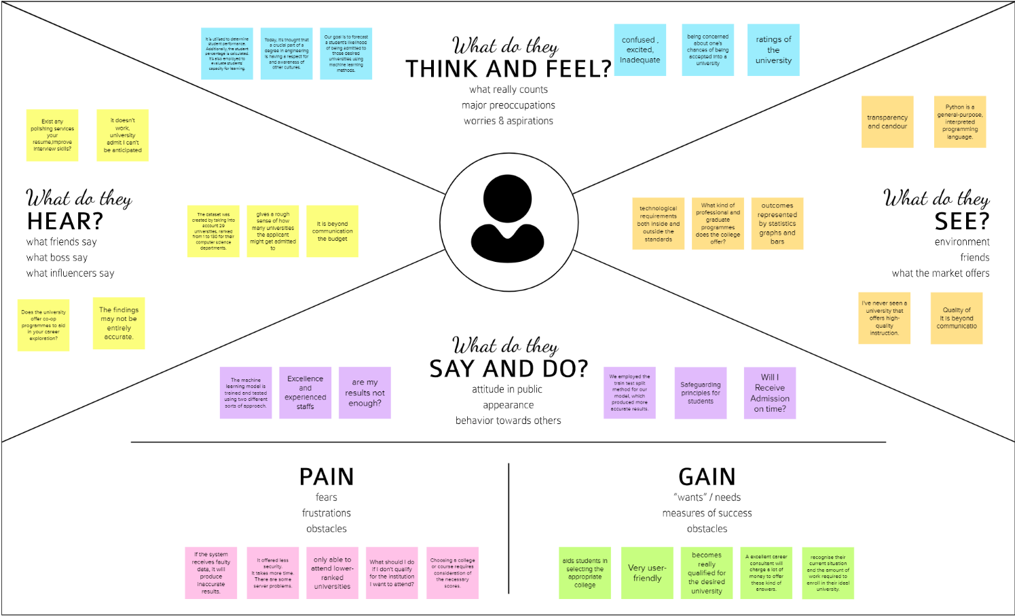
EMPATHY MAP

Slide 7
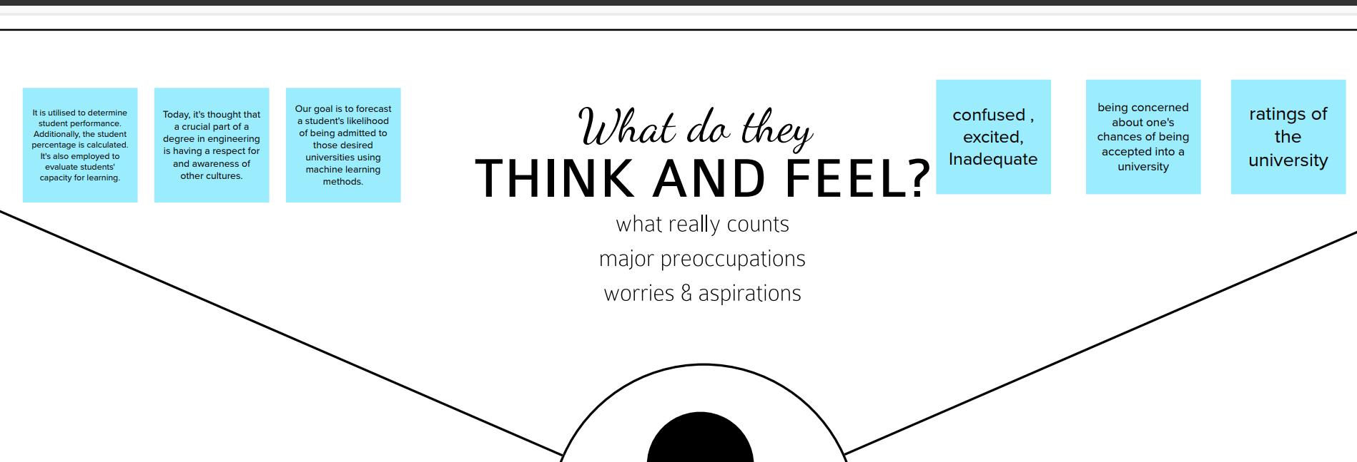

Slide 8
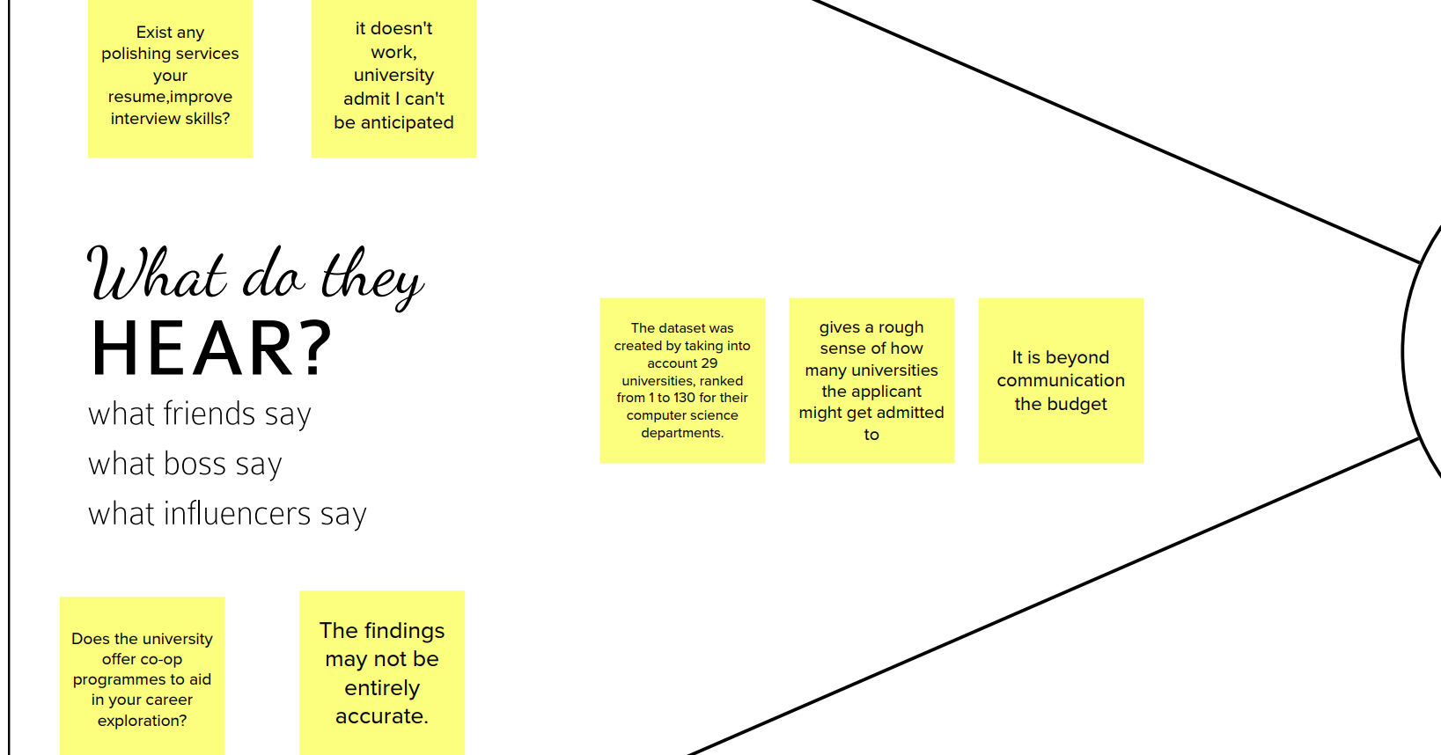

Slide 9
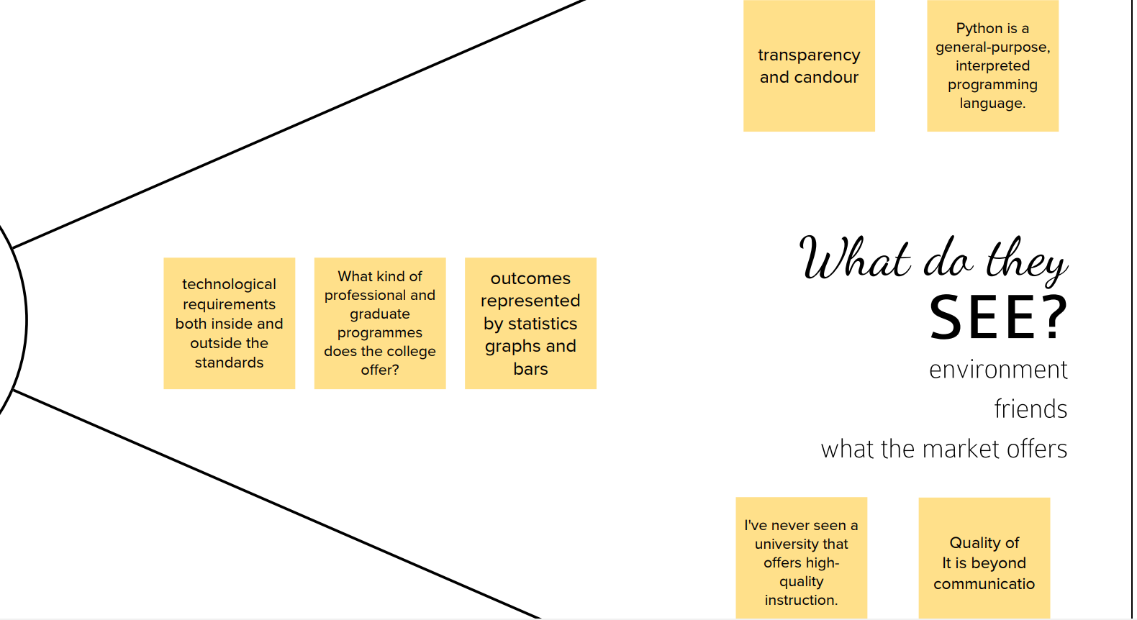

Slide 10
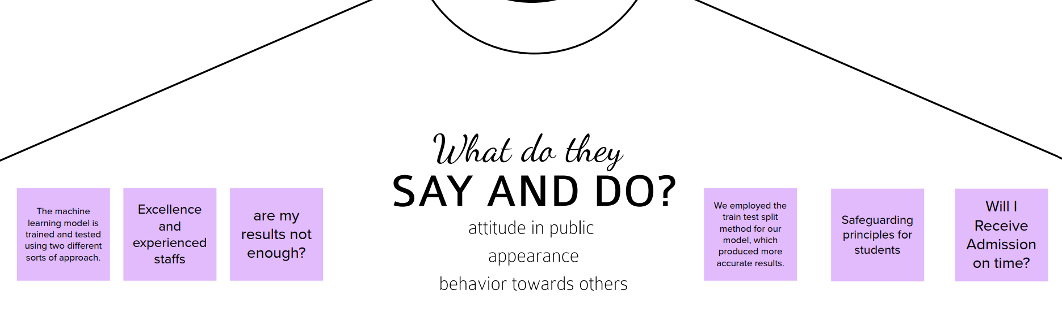

Slide 11
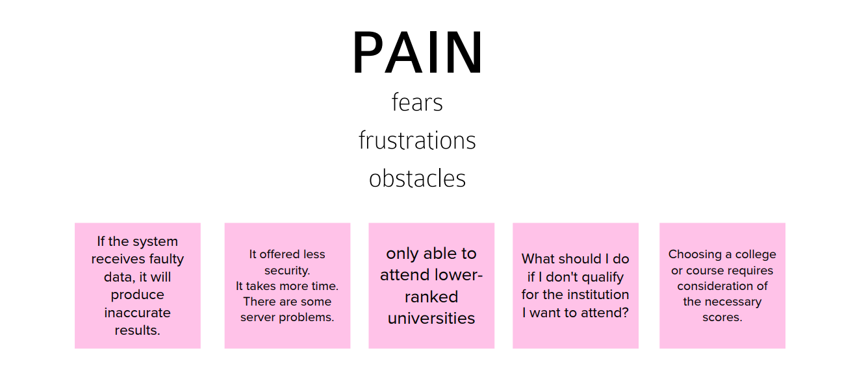

Slide 12
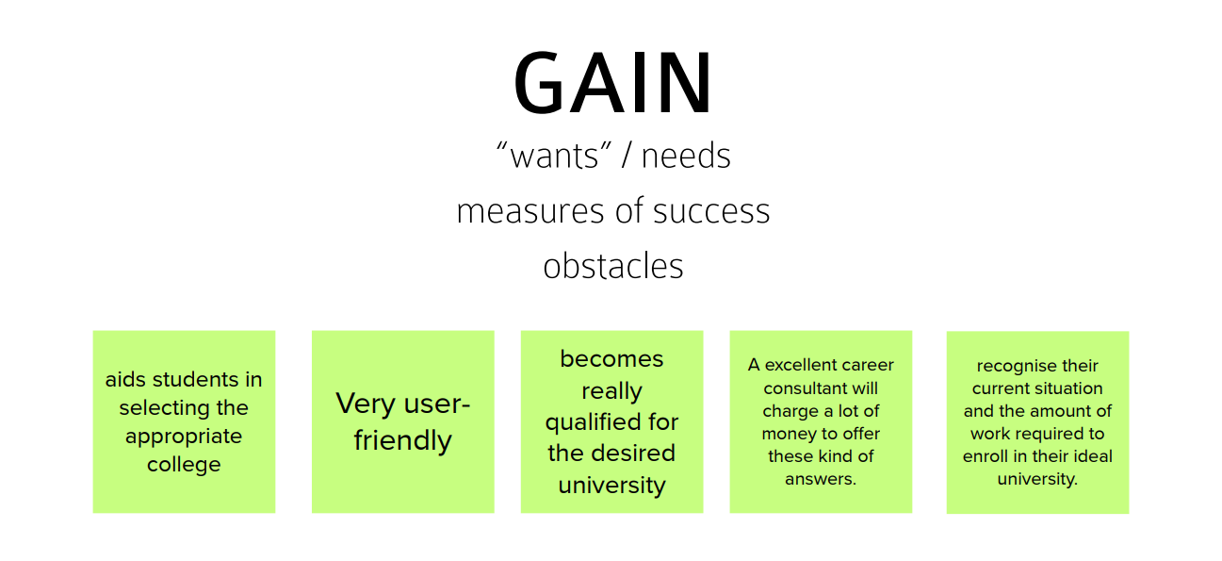

Slide 13
LIST OF IDEAS
There are many softwares that display the list for colleges with a particular star rating when you input your preferred rating (as said during the brain storming sessions).
This idea encouraged us to do a software for Anna University that could provide the availability of the preferred course when the student enters the necessary details that the website asks for.
The prediction of the course is done based on TNEA rank.
We collect the allotment lists of the last 5 years and design the software to make predictions based on that.

Slide 14
PROJECT DESIGN
Current scenario:
Every year, thousands of students who pass out Higher secondary school are aspiring to get into engineering. These students enroll in the admission process conducted by the TNEA(Tamil Nadu Engineering Admission). TNEA allot courses to the students based on the cut-off marks secured by the student.
Aim of the Project:
The software which we intend to do does the same job as TNEA, but in a different way. This software aims in predicting the course that the enrolled student would get for the rank provided to him/her by TNEA.

Slide 15
PROJECT DESIGN
Novelty and Feasibility of Idea:
Through this software Students can know what course they might get in Anna University just by entering their Ranks, cut-off marks, community to which they belong and community marks. Students need not face the difficulty of consulting any third party.
Scalability:
Right now we have used the data set of the last five years. The scalability of this software increases when datasets of previous years are added
Social impact:
People do not waste their money and time approaching third parties to know the availability of their preferred course.

Slide 16
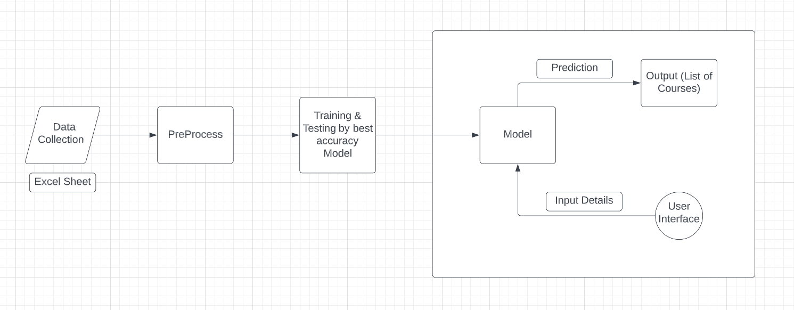
ARCHITECTURE

Slide 17
REFERENCES
[1] Sivasangari, A., et al. "Prediction Probability of Getting an Admission into a University using Machine Learning." 2021 5th International Conference on Computing Methodologies and Communication (ICCMC). IEEE, 2021.
[2] Fathiya, Haseeba, and Lipsa Sadath. "University Admissions Predictor Using Logistic Regression." 2021 International Conference on Computational Intelligence and Knowledge Economy (ICCIKE). IEEE, 2021.
[3] Sridhar, Sashank, Siddartha Mootha, and Santosh Kolagati. "A University Admission Prediction System using Stacked Ensemble Learning." 2020 Advanced Computing and Communication Technologies for High Performance Applications (ACCTHPA). IEEE, 2020.

